Slide 2
MMA841 Operations Management Flow Analysis
Master of Management Analytics– Session 2
Geoff Pond
Notes:
An example of a title page with more specific program details in the title

Slide 3



Flow Analysis
Let’s think about the different things that are important to us in terms of a process:
Flowrate (“throughput rate” or “productivity”)
– does it fail to meet the demand rate? (expect cranky customers)
– does it meet the demand rate? (yay!)
– does it exceed the demand rate? (expect an accumulation of inventory)
- sometimes this is actually a smart strategy

Slide 4

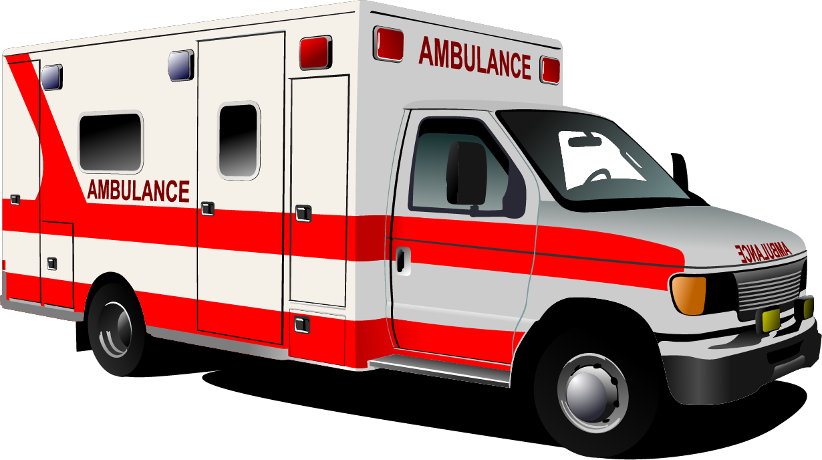
Flow Analysis
Utilization
– are resources (employees and machines) suitably utilized?
- higher utilization rates risk burn-out, increased absenteeism and increased turn-over
- lower utilization rates imply the resource is being less productive (assuming UPT is static)
- expectations for utilization are contextually dependent
Ambulance – resource allocated to meet peak demand (presumably)
Ferry – resource allocated to meet average demand

Slide 5
Flow Analysis
Level Loading
is the utilization of resources relatively consistent across various stages of the process?
if not, can we reallocate labour?
if reallocated from the stage having the lowest utilization to the bottleneck stage, we will have increased resource utilization and the process capacity without spending a single penny. That’s a win!

Slide 6
Flow Analysis
Flowtime (“throughput time”)
– how long WIP takes from the moment it enters a process through to the end of the process
- certainly, as customers we appreciate shorter flowtimes
Inventory
for some service operations, “inventory” can mean the number of customers in a process.
more typically, it represents the volume of WIP on a manufacturing or production line

Slide 7
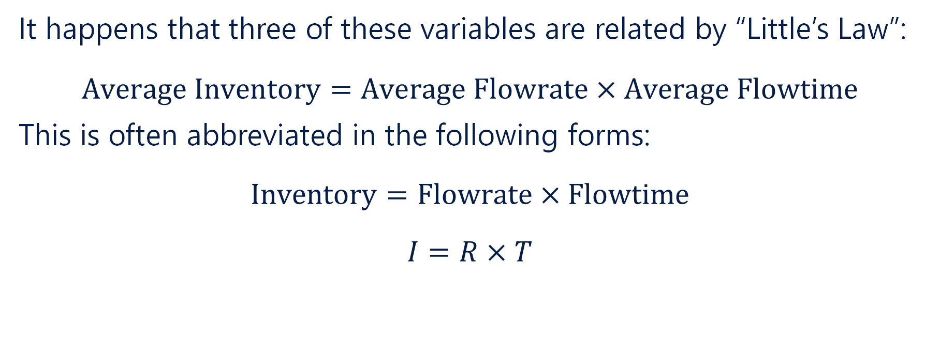
Little’s Law
It happens that three of these variables are related by “Little’s Law”:
$$\text{Average} \text{Inventory}=\text{Average} \text{Flowrate}×\text{Average} \text{Flowtime}$$
This is often abbreviated in the following forms:
$$\text{Inventory}=\text{Flowrate}×\text{Flowtime}$$
$$I=R×T$$

Slide 8
Little’s Law - Application
Little’s Law shows up in many different ways in both OM and Engineering.
It can be applied:
to a single stage of a process
to the process holistically
to an entire organization

Slide 9
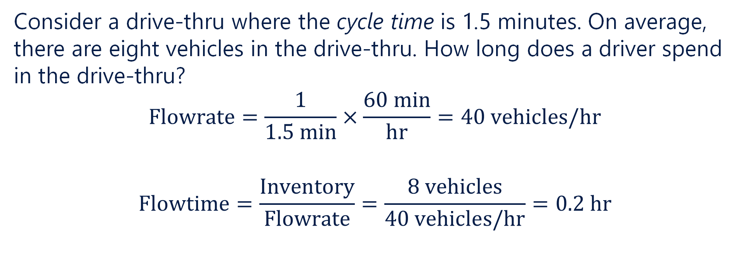
Little’s Law – Application to a Single Stage
Consider a drive-thru where the cycle time is 1.5 minutes. On average, there are eight vehicles in the drive-thru. How long does a driver spend in the drive-thru?
$$\text{Flowrate}=\frac{1}{1.5 \text{min}}×\frac{60 \text{min}}{\text{hr}}=40 \text{vehicles}\text{/}\text{hr}$$
$$\text{Flowtime}=\frac{\text{Inventory}}{\text{Flowrate}}=\frac{8 \text{vehicles}}{40 \text{vehicles}\text{/}\text{hr}}=0.2 \text{hr}$$

Slide 10
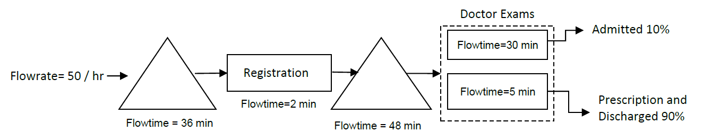
Little’s Law – Application to a Process
Consider the following process:
How many patients are typically in the system?

Slide 11
Little’s Law – Application to an Organization
Home Depot reported 4.2 turns in FY2022 and Net sales of $157,403M (USD)
Lowes reported 3.6 turns in FY2022 and Net Sales of $96,250M (USD)
Which company is holding a greater inventory volume (at retail value)?

Slide 13
MMA841 Operations Management Queuing Theory
Master of Management Analytics– Session 2
Geoff Pond
Notes:
An example of a title page with more specific program details in the title

Slide 14
Manufacturing/Production vs. Service Operations
In high volume manufacturing operations, we enjoy the luxury of knowing:
when the next unit of production will arrive at a specific process stage
how long it will take to process a unit of production at a specific process stage

Slide 15
Variability in Service Operations
Sadly, this is not the case in service operations whether internal to a firm or outward-facing :
customers arrive randomly
service times vary
service expectations vary
service resources vary

Slide 16
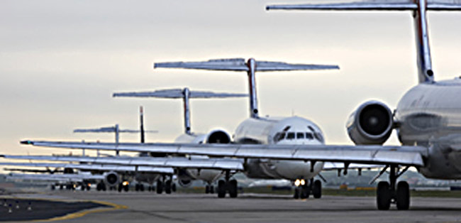
Potential Impacts include…
Customers waiting for extended periods may balk
There may be insufficient space to accommodate the queue length (causing safety problems)
Efficiency/capacity implications (bottlenecks)
Effectiveness implications (e.g., patient conditions may deteriorate)
Just imagine the monetary value of the fuel being burned as these aircraft wait for take-off (Atlanta International)

Slide 17
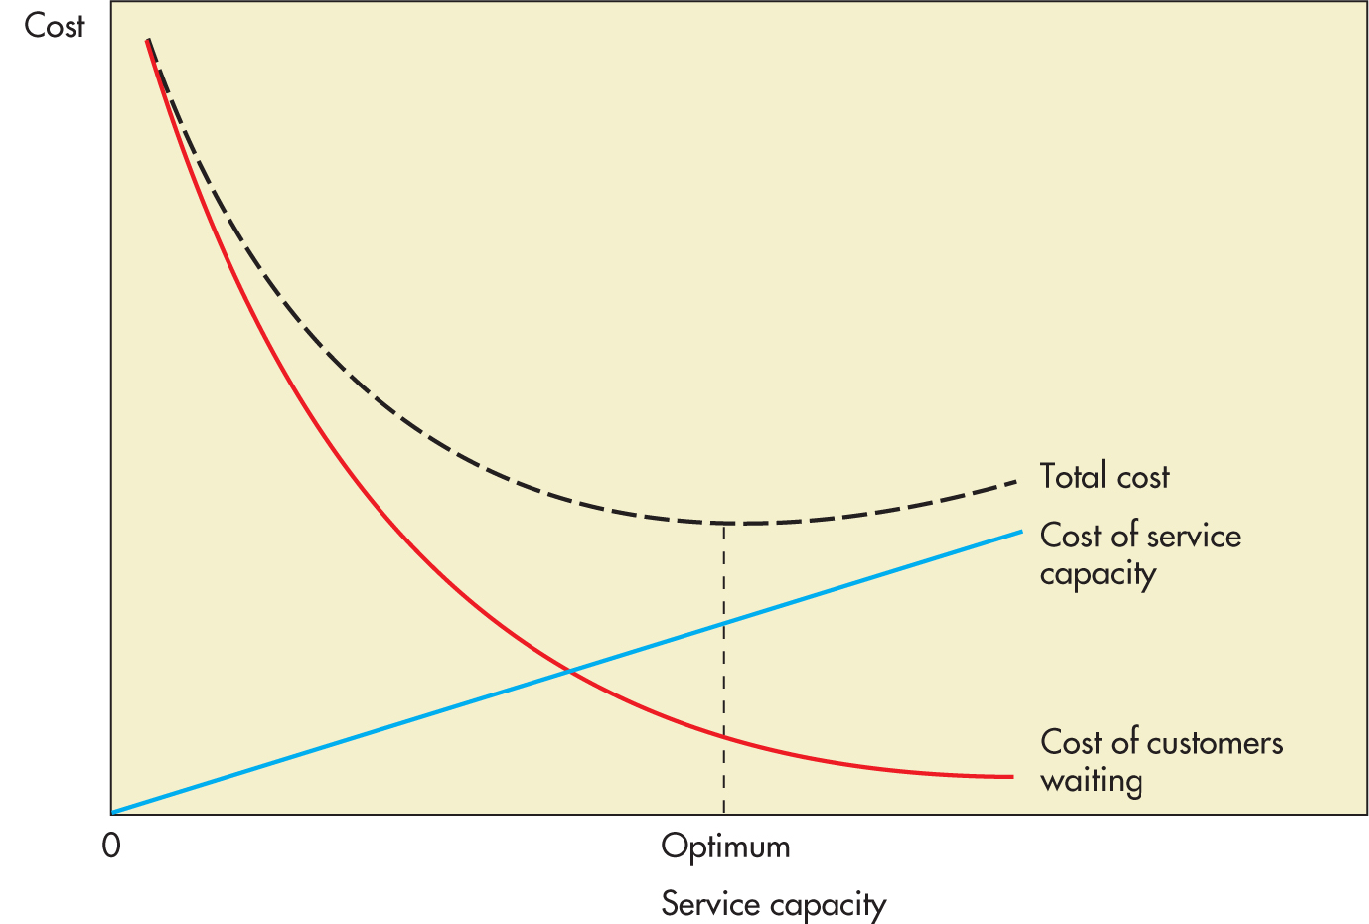
Cost Implications
Generally, waiting costs money (whether it’s a customer’s lost goodwill, or an aircraft burning jet fuel on a taxiway)
Generally, serving customers costs money (whether it’s adding another teller or building an additional runway)
Our goal is to find the “sweet spot” that minimizes total cost.

Slide 18
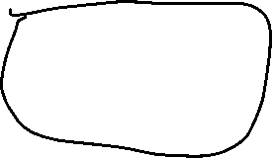
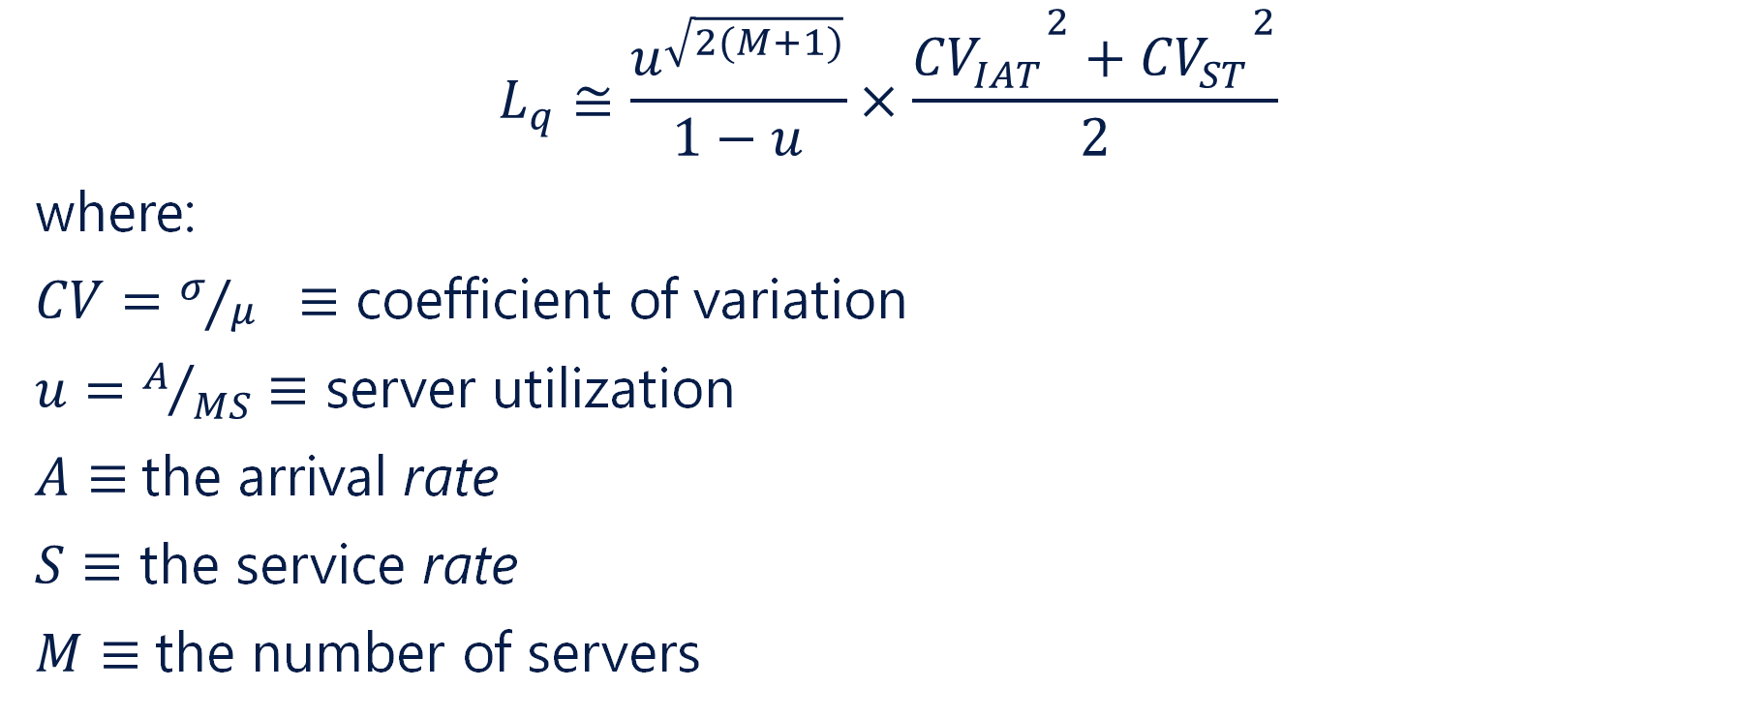
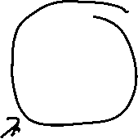
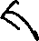
The Math…
$$L_{q}≅\frac{u^{\sqrt{2(M+1)}}}{1−u}×\frac{{{CV}_{IAT}^{}}^{2}+{{CV}_{ST}^{}}^{2}}{2}$$
where:
$CV=σ/μ ≡$ coefficient of variation
$u=A/{MS}≡$ server utilization
$A≡$the arrival rate
$S≡$ the service rate
$M≡$the number of servers

Slide 19
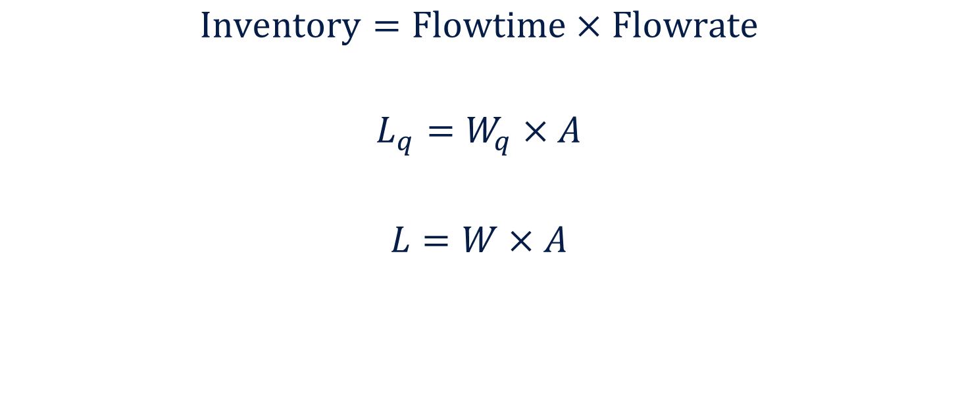
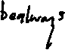
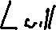
Little’s Law (again)
$$\text{Inventory}=\text{Flowtime}×\text{Flowrate}$$
$$L_{q}=W_{q}×A$$
$$L=W×A$$

Slide 20
Coping With Variability
Historically, we consider two strategies in operations:
Accommodate: do what we can to accommodate the source of variability
Reduction: do what we can to reduce the magnitude of the variability
Frei adds:
Low-Cost Accommodation: means of accommodating variability but without the typically elevated costs
Uncompromised Reduction: rather than reducing the period of peak demand, focusing on increased demand during low-demand periods

Slide 21
Sources of Variability
The Arrival Rate of Service Requests
In service operations, the arrival rate is a source of substantial variability
Coffee shops busy in the morning
Restaurants/bars busy at lunch and after work
Airlines, hotels, car rentals busy during the summer and holiday periods…

Slide 22
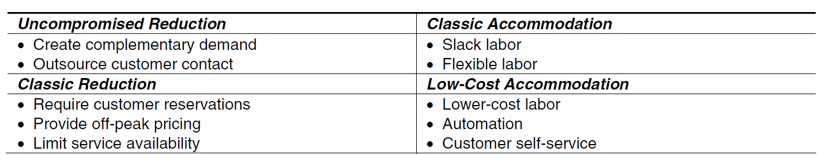
Sources of Variability
Influencing the Arrival Rate of Service Requests

Slide 23
Sources of Variability
Customer Service Expectations
Customers often expect custom experiences:
Not all patients require the same care
Some customers want a simple cash withdrawal while others are taking out a mortgage
Some want dessert and coffee, others want a five-course meal.

Slide 24
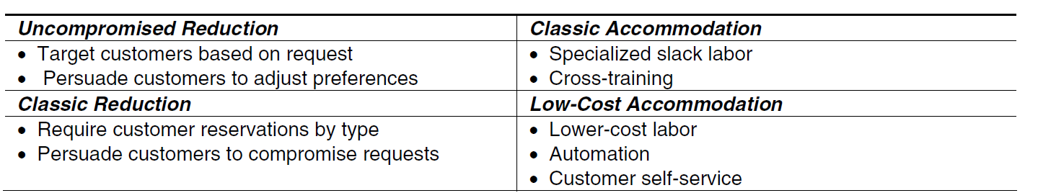
Sources of Variability
Influencing the Customer Service Requests

Slide 25
Sources of Variability
Customer Capabilities (if applicable)
Some customers are quite capable of self-serving while others require substantial support.
Did you book your last flights online… or did you seek the help of a travel agent or reservation agent with your airline?
Self-serve kiosk at the pharmacy & grocery store or traditional cashier?

Slide 26
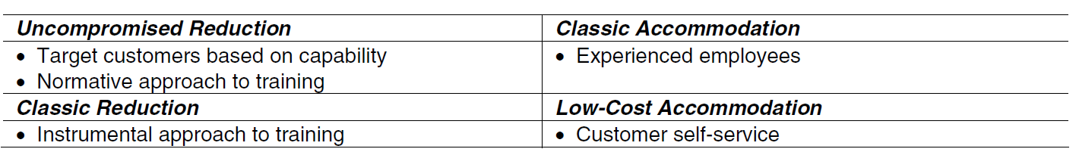
Sources of Variability
Influencing Variability in Customer Capability

Slide 27
Sources of Variability
Customer Effort (if applicable)
Some customers are pro-active and assertive while others are unwilling to exert much effort
I’m very capable of making an online payment for that parking ticket I received last month… but I still haven’t done it.
Some customers will be pressing refresh every two seconds the moment tickets go on sale… others will simply buy from a scalper later on

Slide 28
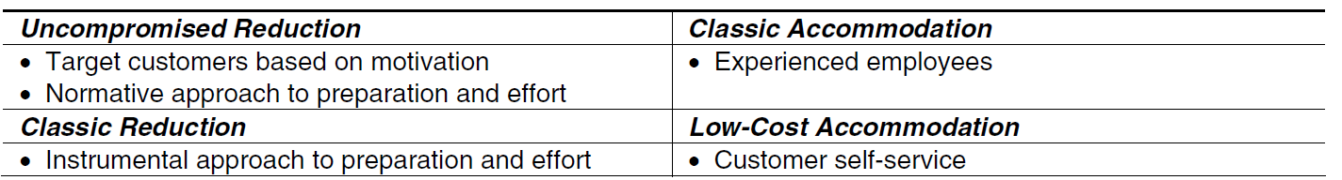
Sources of Variability
Influencing Variability in Customer Effort

Slide 29
Sources of Variability
Customer Preference
In particularly the hospitality industry, customer preferences vary substantially. North Americans often choose the convenience of fast food before carrying on with the evening’s main event while for many cultures, the meal itself is the main event.

Slide 30
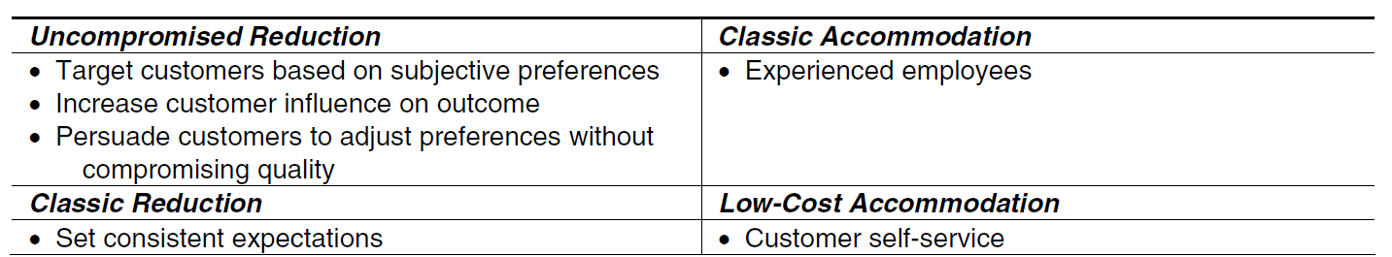
Sources of Variability
Influencing Variability in Customer Preferences

Slide 31
Psychology of Queues
Unoccupied Time Feels Longer than Occupied Time
Pre-Process Waits Feel Longer than In-Process Waits
Anxiety Makes Waits Seem Longer
Uncertain Waits Are Longer than Known, Finite Waits
Unexplained Waits Are Longer than Explained Waits
Unfair Waits are Longer than Equitable Waits
Maister, D.H. (1984). Psychology of Waiting Lines, Harvard Business Review.

Slide 32
Queue Strategy
Keep progress moving. We’re often satisfied as long as we’re getting closer to the goal, even if its slowly.
Avoid designing queues where the consumers move away from the service desk.
If necessary, do it as late as possible in the queue
Get consumers “in the system” ASAP. Consider a tiered (or multi-phase) service
Social Justice: FIFO is viewed as being most equitable but don’t always happen (think about multiple queues each associated with an independent server where one moves faster than the other)
Soman, D. (2013). The Waiting Game: The Psychology of Time and its Effects on Service Design, Rotman Magazine.

Slide 33
Queue Strategy - Scheduling
First-in, First-out (FIFO) is not particularly efficient
Shortest Processing Time (SPT) minimizes the average flowtime
Earliest Due Date (EDD) minimizes maximum lateness
FIFO is accepted from a social-justice perspective

Slide 34
Queue Strategy
Know consumer expectations! How long will consumers accept waiting in line?
Keep service rates consistent when possible.
Distract them (music, televisions, magazines, etc.)
Keep customers informed
Self-service
Staff not directly involved in serving customers should be kept out-of-sight
Stay friendly!

